Slide 1

Power Flow Analysis
Mathcad
Bryce Smith/James Albert/Meron Asfaw/Tian Ying/Jun Lee/John Ruffy
Group 2
Project 6
ECE 128A Winter, 2020
Notes:
The project is about Power System Load Flow Analysis using Mathcad. We create a MATHCAD program, similar to the Excel program that was given to us. The program development and design have been implemented to provide a variety of choices for the users input. It is made by six elite power engineers from simple computer desktop tools. Therefore, the program has a simple interface to run different operations with interactive tools to accommodate a user-friendly environment.

Slide 2

Introduction
What is power flow?
What does our program do?
Why is it important?
Notes:
The general studies of power-flow or load-flow power engineering concluded that, the studies are a numerical analysis of the flow of electric power in an interconnected system.
Our program mentaine and analyze electrical power system provided voltages at all the buses, power flows and losses in the lines at specific levels of power generation and loads used in load forecasting, system planning and operation.
It is important because, as the studies revealed, it is essential to decide the best operation of existing system and for planning the future expansion of the system. It helps in designing a new power system network. It helps in System loss minimization and transformer tap setting for economic operation.

Slide 3
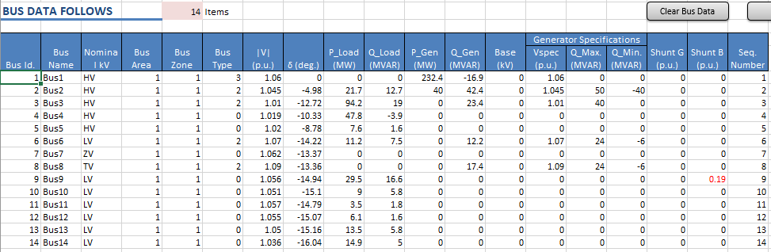
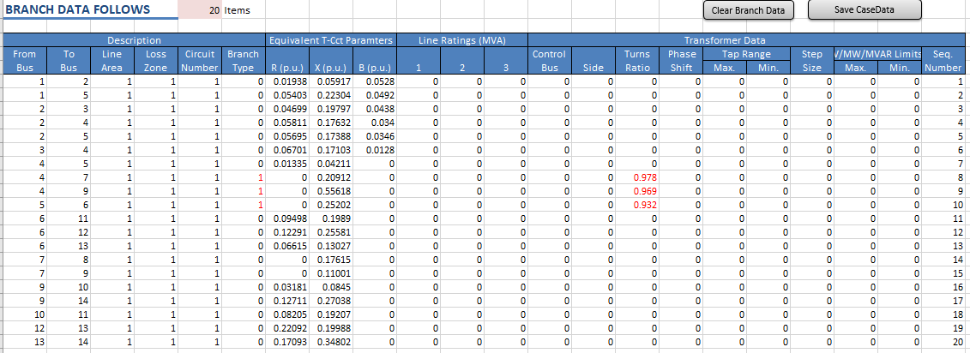
Excel Bus and Branch Data

Slide 4
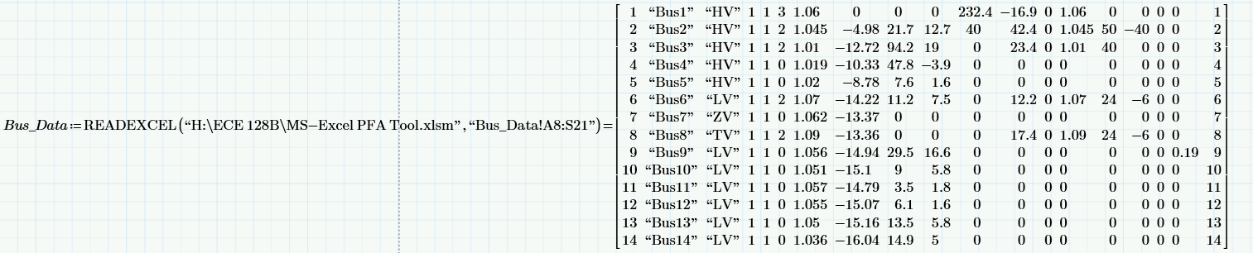
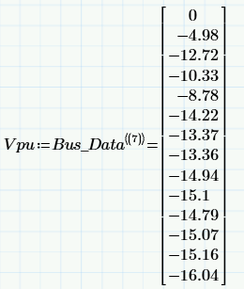
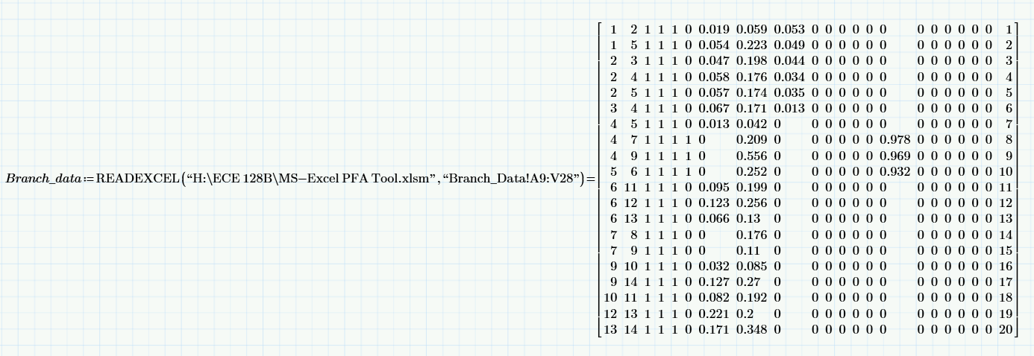
Mathcad Bus and Branch Data
Extracting data from matrix
Reading data from excel

Slide 5
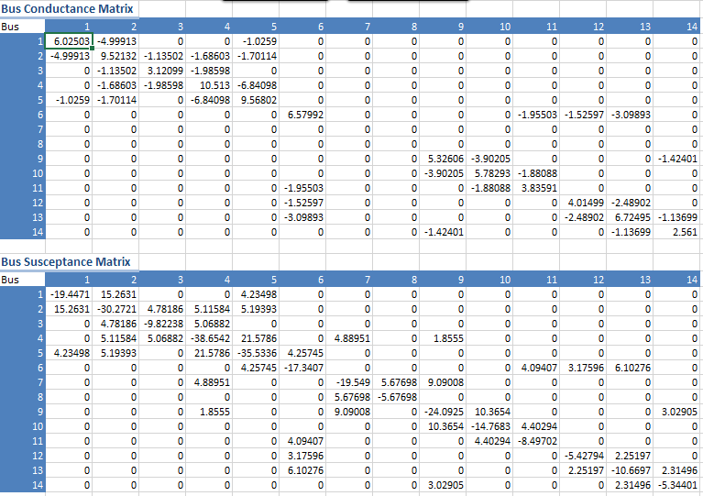
Excel Y-bus Data

Slide 6
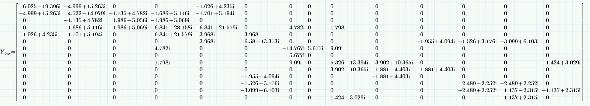
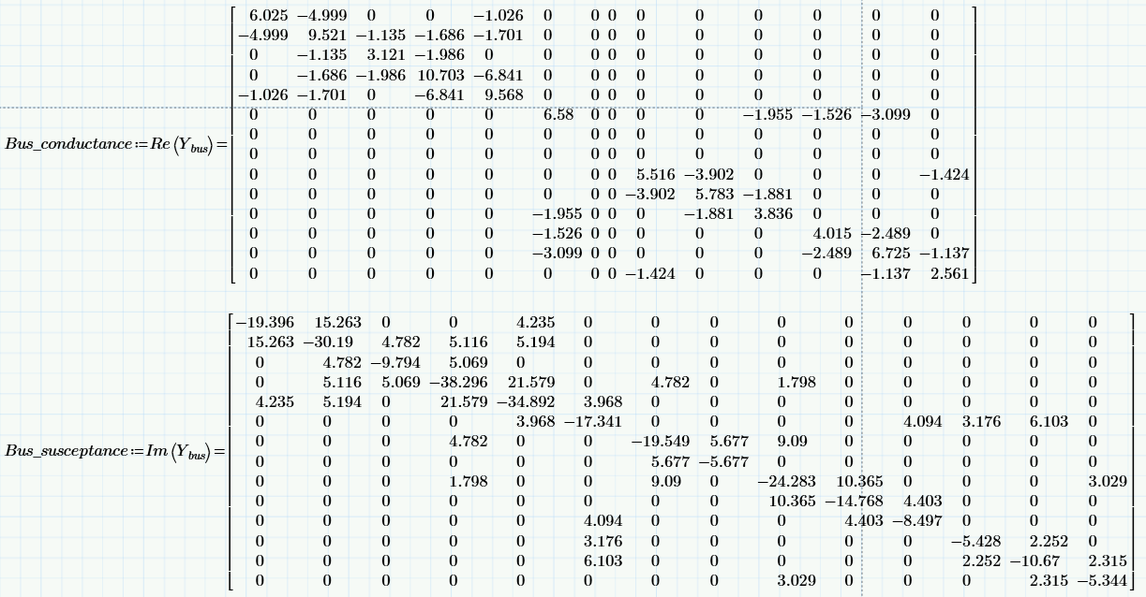
Mathcad Y-bus
Admittance = Conductance + Susceptance

Slide 7
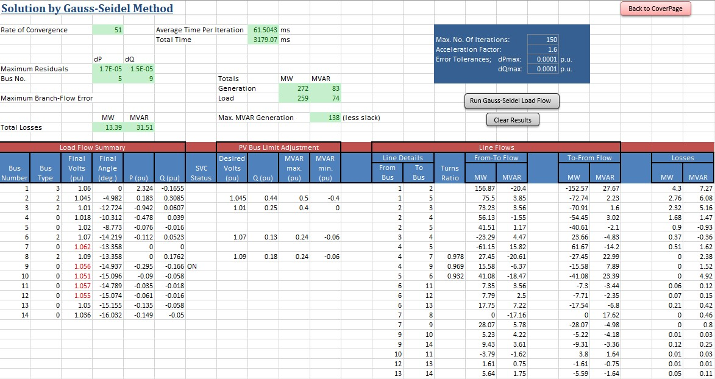
Gauss-Seidel Analysis
To calculate the final voltage and its angle, we iterate through the data many times (approx. 150) calculating the voltage for each bus based off of the Y-bus data, scheduled P and Q data, and the Vpu for each bus.
Notes:
This method of analysis requires many iterations in order for the equations to converge, but can take less total time to calculate when the system is small enough.

Slide 8

Newton-Raphson Analysis
This method uses a Jacobian matrix formed from the Y-bus data to give us the final voltage and its angle. While this method takes less iterations, it can take more time due to the complexity of the Jacobian matrix. Similar to the GS Method, we can use this voltage and angle in addition to the known load values to find the P and Q values.

Slide 9
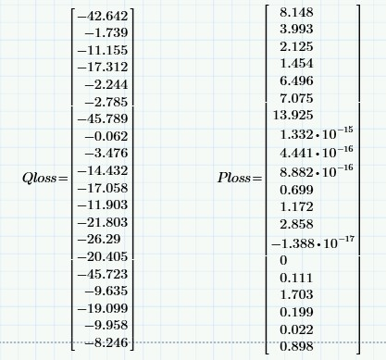
Line Flow Losses
The line flows are calculated from the final voltage and angle data from each bus and we are able to use the branch data between the busses to determine the real and imaginary power losses

Slide 10
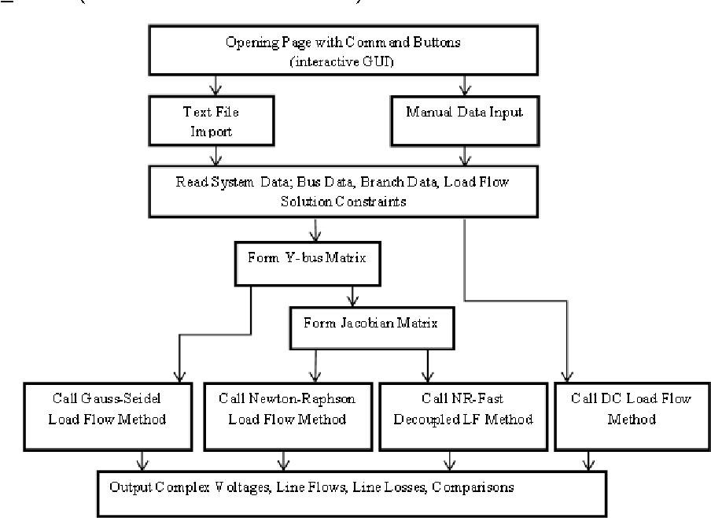
Conclusion
Notes:
In numerical analysis, the speed at which a convergent sequence approaches its limit is called the rate of convergence. The convergence in Newton-Raphson is better when compared to other load flows (like Gauss-Seidel, FDC, NDC). A too low value of lambda(acceleration factor) will delay convergence but a very high value may skip desired solutions, and diverge consequently. So, in order to increase the convergence speed , acceleration factor is used. The lambda should be chosen based on trial and error methods. Generally, the lambda we chose best to fit be is in the range of 1.6 to 1.8. However it changes from one power system study to another.

